Slide 1


Oracle database
Lecture 36

Slide 2

Today’s Agenda
Introduction To PL-SQL
Advantages Of PL-SQL
PL-SQL Architecture
Example

Slide 3
Introduction To PL-SQL
The PL/SQL stands for Procedural Language extensions to Structured Query Language.
Basically, SQL is used to perform basic operations like:
creating a database
storing data in the database
updating data in the database
retrieving the stored data of database etc

Slide 4
Introduction To PL-SQL
On the other hand PL/SQL is a fully Structured Procedural language which enables the developer to combine the powers of SQL with its procedural statements , to create super powerful SQL queries.
This enhances the security, portability, and robustness of the database as well as gives more control to the programmers by the use of loops, conditions and object-oriented concepts

Slide 5
Drawbacks Of SQL
SQL does not provide the programming techniques of condition checking, looping and branching which is very important
SQL has no facility of error handling.

Slide 6
Drawbacks Of SQL
SQL statements are passed to the Oracle Engine one at a time.
While executing SQL statement, each time a call is made to the engine's resources.
This increases traffic in the network and decreases the speed of data processing especially in a multi-user environment.

Slide 7
Advantages Of PL-SQL
Reduces network traffic This is one of the greatest advantages of PL/SQL. Since PL/SQL allows us to club an entire block of SQL statements for execution into oracle engine , all at once , so it helps us in reducing the network traffic.
Procedural language support PL/SQL provides the conditional checking, looping or branching operations just like any programming language.
Error handling It provides facility to deal with errors, as required and displays user-friendly messages when error occurs.

Slide 8
Advantages Of PL-SQL
Declare variable PL-SQL allows declaration and use of variables in blocks of code. These variables are used to store intermediate results of a query for later processing either in SQL or PL/SQL.
Portable application Applications written in PL/SQL are portable to any computer hardware and operating system, where Oracle is operational.

Slide 9
PL-SQL Architecture
The PL/SQL architecture mainly consists of following three components:
PL/SQL block
PL/SQL Engine
Database Server

Slide 10
PL-SQL Block
This is the component which has the actual PL/SQL code.
It consists of different sections to divide the code logically (declarative section for declaring purpose, execution section for processing statements, exception handling section for handling errors)

Slide 11
PL-SQL Block
It also contains the SQL instruction that used to interact with the database server.
All the PL/SQL units are treated as PL/SQL blocks, and this is the starting stage of the architecture which serves as the primary input.

Slide 12
PL-SQL Engine
PL/SQL engine is the component where the actual processing of the codes takes place.
PL/SQL engine separates PL/SQL units and SQL part in the input.

Slide 13
PL-SQL Engine
The separated PL/SQL units will be handled by the PL/SQL engine itself.
The SQL part will be sent to database server where the actual interaction with database takes place.

Slide 14
Database Server
This is the most important component of Pl/SQL unit which stores the data.
The PL/SQL engine uses the SQL from PL/SQL units to interact with the database server.
It consists of SQL executor which parses the input SQL statements and execute the same.

Slide 15
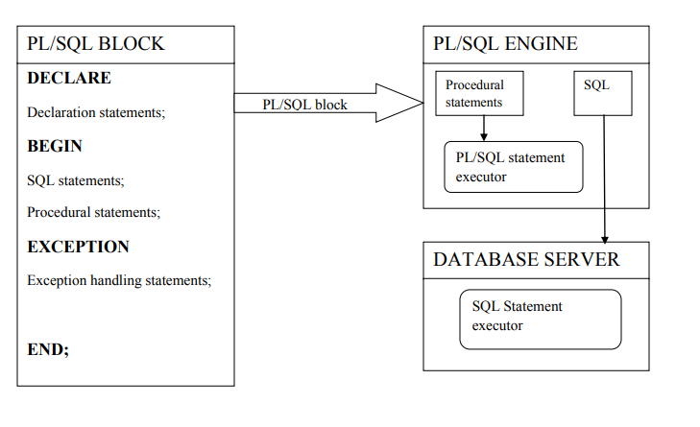
PL-SQL Architecture

Slide 16
The PL-SQL Block
PL/SQL program units organize the code into blocks.
A block without a name is known as an anonymous block.
The anonymous block is the simplest unit in PL/SQL.
It is called anonymous block because it is not saved in the Oracle database.

Slide 17
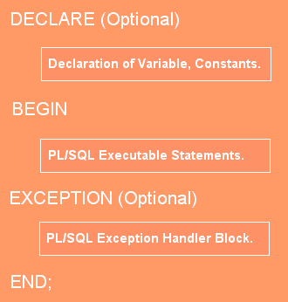
The PL-SQL Block
DECLARE
Variables and constants are declared, initialized within this section.
BEGIN
This block is a procedural statement block which will implement the actual programming logic. This section contains conditional statements (if...else), looping statements (for, while) etc
EXCEPTION
A PL/SQL block has an exception-handling section that starts with the keyword EXCEPTION. The exception-handling section is where we catch and handle exceptions raised by the code in the execution section.

Slide 18
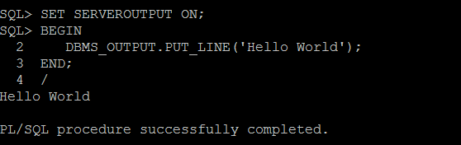
An Example
The following example shows a simple PL/SQL anonymous block with one executable section:

Slide 19
Code Explained
The SET SERVEROUTPUT ON command is not a PL-SQL command but it is used to instruct SQL*Plus to echo database’s output after executing the PL/SQL block.
The DBMS_OUTPUT.PUT_LINE is called a procedure whose main task is to output a string on the screen.
To run a PL-SQL code we use /

